Slide 1


Project Work Proposal Defense
On
Mero Diary: A Secure Web-Based Personal Journaling and Activity Recommendation Application
Presented by:
Abhinav Singh Thapa (79010398)
Babita Subedi (79010404)
Khusi Dahal (79010410)
B.Sc. CSIT 4th year/ 7th Semester(2079B.S)
Magh 2026

Slide 2
Presentation Outline
About Project Topic
Literature Review
Methodology
Time Scheduling
Conclusion
References and Bibliography

Slide 3
About Project Topic
Mero Diary is a secure web-based personal journaling system.
Allows users to record daily life events, activities, and health-related data.
Focuses strongly on privacy, confidentiality, and data security.
Uses encryption and secure authentication mechanisms.
Provides personalized activity recommendations to support user well-being.
Problem Statement
Users hesitate to store personal thoughts online due to privacy and security concerns.
Existing diary apps lack meaningful analysis and wellness guidance.
Manual journaling does not help users improve habits effectively.

Slide 4
Objectives
Provide a secure platform for digital journaling.
Protect user data using encryption and secure authentication.
Generate personalized activity recommendations for better well-being.
Scope
Secure login, encrypted diary entries.
Daily journaling and wellness tracking.
Basic data visualization and recommendations.
Recommendation of activities
Limitations
Recommendation accuracy improves only with sufficient user dataset
Not feasible for more than 10 users due to resource constraint

Slide 5
Review of Existing Systems
Day One Journal
A popular digital journaling application used across multiple platforms.
Provides strong encryption to protect user diary entries.
Includes mood tracking features and guided prompts for daily reflection.
However, it does not offer predictive or data-driven wellness recommendations based on user behavior or historical data.
Penzu
A secure online diary platform focused primarily on privacy.
Uses AES-256 zero-knowledge encryption, ensuring that even the service provider cannot access user content.
While it ensures high confidentiality, it lacks analytics and personalized insights to help users improve habits or well-being.

Slide 6
Study of current system
Security Focus in Digital Journals: Existing systems prioritize encryption and authentication
(AES, bcrypt, JWT), but often overlook personalized wellness analytics and predictive activity suggestions [1], [7].
AES-128 Effectiveness: AES-128 combined with HTTPS and client-side key management provides secure,
real-time journal entry protection with low processing time (~0.84 seconds),
suitable for resource-constrained environments [1], [5].
Limitations of Commercial Apps: Apps like Day One and Penzu offer end-to-end
encryption and mood tracking, but lack predictive activity suggestions and analytics-driven
well-being insights [2], [4].
Advanced Authentication Methods: JWT authentication with bcrypt hashing enables secure,
stateless, cross-device user access, outperforming traditional session-based models [3], [8].
Predictive Analytics: Linear regression can quantify behavioral data to predict wellness outcomes,
forming a basis for activity optimization [6].
Hybrid Recommendation Systems: Combining rule-based logic, regression, and ensemble methods
like random forests improves personalized wellness recommendations compared to single-model
approaches [7].

Slide 7
Security Techniques from Literature
AES encryption is widely recognized as an efficient and reliable method for securing sensitive data
at rest.
HTTPS is essential for protecting data during transmission and preventing unauthorized access.
Bcrypt password hashing and JWT authentication provide scalable, stateless, and secure user
authentication mechanisms suitable for modern web applications.

Slide 8
Research Gaps Identified
Most journaling apps focus only on storage and privacy.
Very limited use of analytics for well-being improvement.
Proposed Improvement
Hybrid recommendation system using:
Rule-based logic
Linear regression
Random Forest algorithms
Combines security with wellness insights.

Slide 9
Methodology
Requirement Elicitation
Literature review of existing journaling apps.
Study of previous research papers.
Observation of user journaling behavior.
Requirements (Hardware/Software)
Hardware
Laptop/Desktop
Internet connection
Software
Frontend: ReactJS
Backend: Node.js, Express
Database: Firebase/Supabase
Security: bcrypt, JWT, AES
Recommendation Engine: Python

Slide 10
Process Model
Agile Model
Easy iteration
Continuous testing and improvement

Slide 11
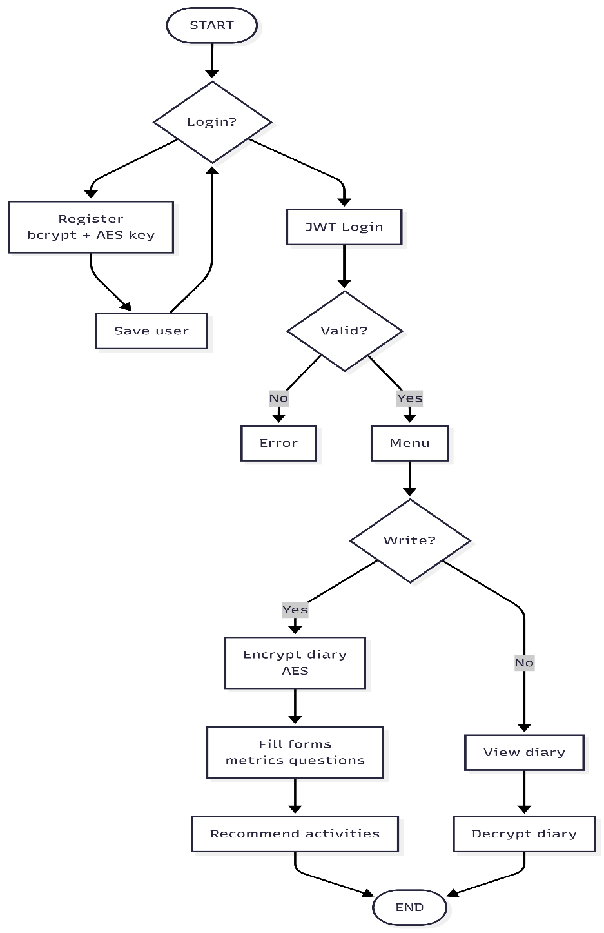
flowchart

Slide 12
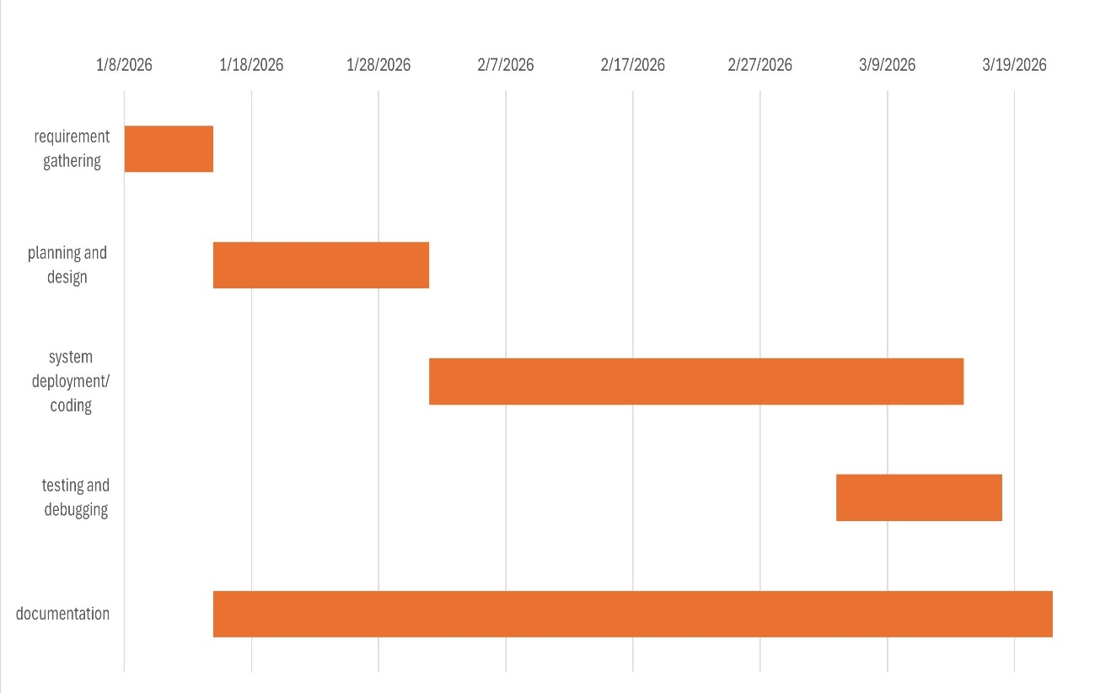
Time Scheduling
Gantt Chart
Requirement Analysis – Week 1
Design – Week 2
Development – Week 3–4
Testing – Week 5
Final Presentation – Week 6

Slide 13
Conclusion
Mero Diary ensures secure and private digital journaling.
Combines encryption with wellness analytics.
Encourages healthier habits through recommendations.

Slide 14
Expected Outcomes
Secure web-based diary system.
Encrypted user data and safe authentication.
Personalized wellness activity suggestions.
Visual insights into user habits.

Slide 15
References
[1] A. H. Nasrullah, “Secure web-based file encryption using AES-128,” Journal of Embedded Systems, Security and Intelligent Systems, vol. 6, no. 2, pp. 146–155, 2025.
[2] Day One Journal. [Online]. Available: https://dayoneapp.com. Accessed: Jan. 2026.
[3] J. Garcia and S. Kim, “JWT authentication in modern web applications,” IEEE Transactions on Information Forensics and Security, vol. 18, pp. 1234–1245, 2023.
[4] Penzu: Secure Online Diary. [Online]. Available: https://penzu.com. Accessed: Jan. 2026
[5] Z. Luo et al., “Optimization of AES-128 encryption algorithm,” Security and Communication Networks, vol. 2022, Art. no. 123456, 2022.
[6] R. Smith et al., “Linear regression for wellness prediction,” Journal of Biomedical Informatics, vol. 115, p. 103712, 2021.
[7] A. Kumar et al., “Hybrid recommender framework for wellness apps,” PeerJ Computer Science, vol. 10, p. e1880, 2024.
[8] M. Patel and H. Lee, “Bcrypt-JWT security in web applications,” Computers & Security, vol. 128, p. 103156, 2023.

